Slide 1



Capstone Project North Wind Traders Sales Analytics
By – Divyansh Mishra

Slide 2


Topics
Project Overview
Key Components of Report
Information about Dataset Tables
Data Cleaning and MECE
Power BI Questions Discussions
EDA Questions Discussions
Dashboard Analysis

Slide 3
Project Overview
Objective: The objective of this Power BI report is to develop a comprehensive dashboard for Northwind Traders, a fictitious company specializing in importing and exporting specialty foods. The report aims to provide valuable insights into various aspects of the company's operations, including sales analysis, customer segmentation, inventory trends, and employee performance. The primary goal is to facilitate data-driven decision-making processes for stakeholders by presenting key performance metrics in an intuitive and visually appealing manner.
Dataset Description: The dataset used for this project is the Northwind database, containing sales data for Northwind Traders. It comprises several interconnected tables, including Customers, Employees, Orders, Order Details, Products, Suppliers, Shippers, and Categories. Each table contains specific information related to customers, employees, orders, products, suppliers, and shipping details, enabling comprehensive analysis of the company's operations.

Slide 4
Key Components of the Report:
Sales Analysis:
Visualizations depicting sales trends over time, including total sales, sales by product category, and geographical distribution of sales.
Analysis of top-selling products, customer segments, and sales performance by region or customer demographics.
Customer Segmentation:
Segmentation of customers based on various attributes such as geographic location, purchase history, and customer type.
Customer retention analysis and identification of high-value customers for targeted marketing strategies.
Inventory Trends:
Visualizations illustrating inventory levels, including stock availability, products on order, and reorder levels.
Analysis of inventory turnover rates, identifying slow-moving or obsolete products.
Employee Performance:
Evaluation of employee performance metrics such as sales contribution, order processing time, and customer satisfaction ratings.
Comparison of performance across different sales territories or teams.

Slide 5
Information about Dataset Tables
What is Dataset ?
A dataset is a collection of data.
In this Project, we have got dataset from a company called “Northwind Traders”. A company that deals with importing and exporting food items across different countries.
In this dataset, we have 8 different tables.
Customers Table
Employees Table
Orders Table
Order Details Table
Products Table
Suppliers Table
Shippers Table
Categories Table

Slide 6
Information about Dataset Tables Continue
1. Customers Table: - This table stores information about the company's customers. It includes fields for customer ID, company name, contact name, contact title, address, city, region, postal code, country, phone and fax.
2. Employees Table: - This table stores information about the company's employees. It includes fields for employee ID, last name, first name, title, title of courtesy, birth date, hire date, address, city, region, postal code, country, home phone, extension, photo, notes, reports to, and photo path.
3. Orders Table: - This table stores information about the company's orders. It includes fields for order ID, customer ID, employee ID, order date, required date, shipped date, ship via, freight, ship name, ship address, ship city, ship region, ship postal code, and ship country.
Order Details Table: - This table stores detailed information about the items within each order. It includes fields for order ID, product ID, unit price, quantity, and discount.

Slide 7
Information about Dataset Tables Continue
5. Products Table: - This table stores information about the company's products. It includes fields for product ID, product name, supplier ID, category ID, quantity per unit, unit price, units in stock, units on order, reorder level, and whether the product is discontinued.
6. Suppliers Table: - This table stores information about the company's suppliers. It includes fields for supplier ID, company name, contact name, contact title, address, city, region, postal code, country, phone, fax, and home page.
7. Shippers Table: - This table stores information about the company's employees. It includes fields for employee ID, last name, first name, title, title of courtesy, birth date, hire date, address, city, region, postal code, country, home phone, extension, photo, notes, reports to, and photo path.
8. Categories Table: - This table stores information about the company's orders. It includes fields for order ID, customer ID, employee ID, order date, required date, shipped date, ship via, freight, ship name, ship address, ship city, ship region, ship postal code, and ship country.

Slide 8
Clean Dataset Tables
1. Customers Table: - After cleaning the unnecessary columns. It includes fields for customer ID, company name, contact name, contact title, city, country.
2. Employees Table: - After cleaning the unnecessary columns. It includes fields for employee ID, last name, first name, title, title of courtesy, birth date, hire date, city, country
3. Orders Table: - After cleaning the unnecessary columns in the company's orders table. It includes fields for order ID, customer ID, employee ID, order date, required date, shipped date, ship via, freight, ship name, ship city, and ship country.
4. Order Details Table: - After cleaning the unnecessary columns in the company's order details table. It includes fields. It includes fields for order ID, product ID, unit price, quantity, and discount.

Slide 9
Clean Dataset Tables
5. Products Table: - After cleaning unnecessary data. It includes fields for product ID, product name, supplier ID, category ID, quantity per unit, unit price, units in stock, units on order, reorder level, and whether the product is discontinued.
6. Suppliers Table: - After cleaning unnecessary data. It includes fields for supplier ID, company name, contact name, contact title, city, region, postal code, country,
7. Shippers Table: - After cleaning unnecessary data. It includes fields for employee ID, last name, first name, title, title of courtesy, birth date, hire date, city, region, postal code, country.
8. Categories Table: - After cleaning unnecessary data. It includes fields for order ID, customer ID, employee ID, order date, required date, shipped date, ship via, freight, ship name, ship ship city, and ship country.

Slide 10
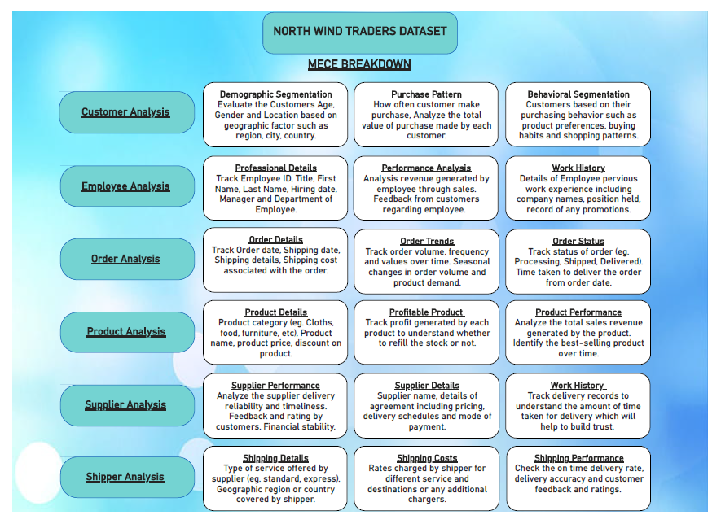
MECE Breakdown

Slide 11
Power Bi Questions

Slide 12
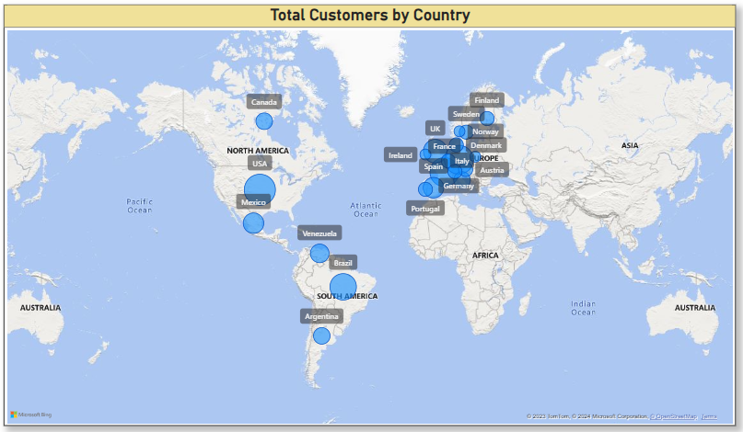
Power Bi Question
1. How does customer distribution vary across different regions or customer segments? Can we visualize it on a map or bar chart?
Answer:
Yes, we can visualize using Map Chart to understand Total Customers across different countries.

Slide 13
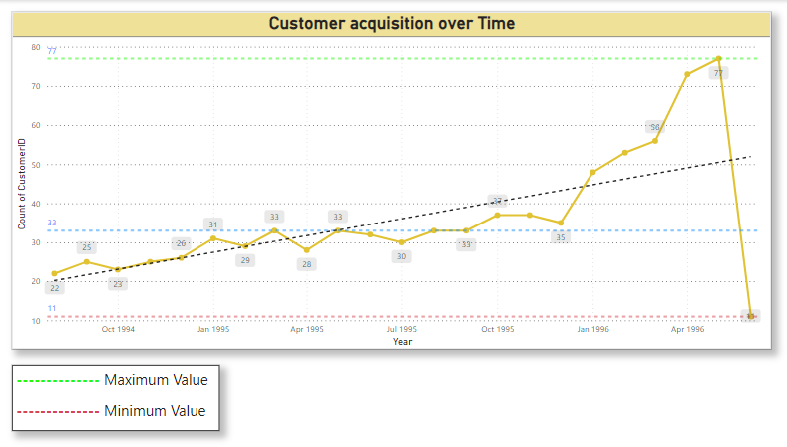
Power Bi Question
2. What is the trend in customer acquisition over time? Can we create a line chart or area chart to display it ?
Answer:
Yes, we can create line chart to visualize the trend in customer acquisition over time. It help us to understand customers behavior changing over the years.

Slide 14
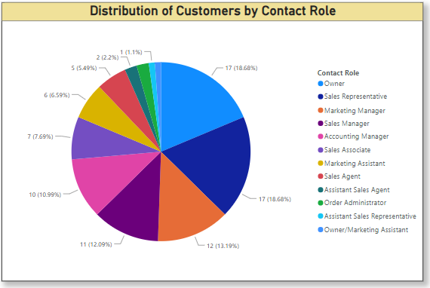
Power Bi Question
3. Can we visualize the distribution of customer demographics such as age, gender, or income using histograms or pie charts ?
Answer:
Yes, we can create pie chart to visualize customer distribution. It shows 17 customers having contact role as Owner which is 18.68% of customers.

Slide 15
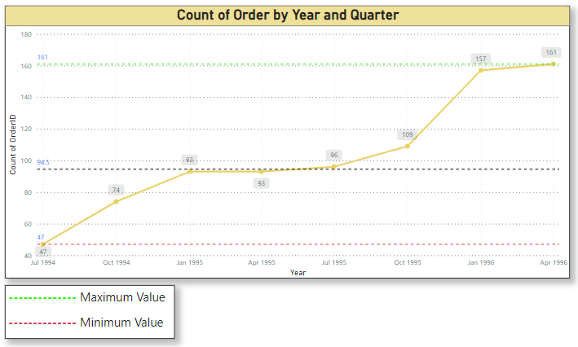
Power Bi Question
4. How does order volume change over time ? Can we create a time series chart or stacked bar chart to visualize it ?
Answer:
Yes, we can create line chart for time visualization. It display no. of orders over different quarter and year. Which will help us to identify orders trend over time.

Slide 16

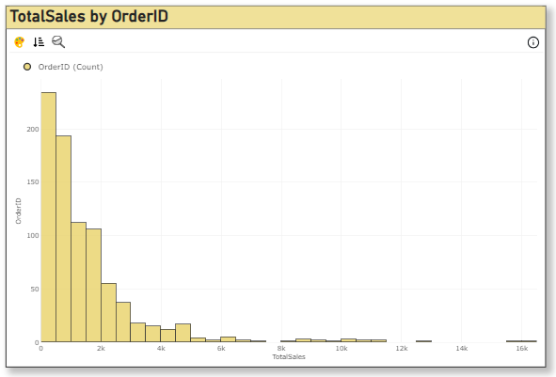
Power Bi Question
5. What is the distribution of order values ? Can we create a histogram or box plot to display it ?
Answer:
Yes, we can create histogram chart to understand order values as Total Sales using no. of orders. Which will help us to gain information about how much orders vary in different total sales range. Maximum orders lies between 0 to 2000 having 234 orders.

Slide 17
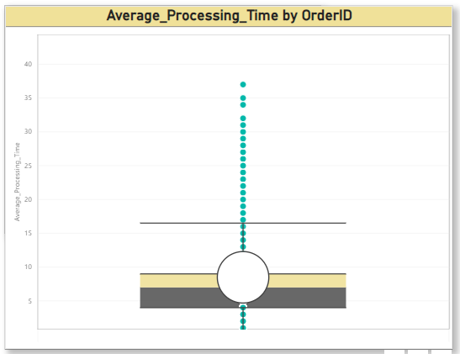
Power Bi Question
6. Can we visualize the average order processing time or shipping duration using a bar chart or box plot ?
Answer:
Yes, we can create box plot chart. It help us to identify outliers. The median processing time (the middle of the box) is around 7 days and mean is 8.49 days.
The interquartile range (IQR), represented by the box itself, is around 5 days, indicating that the middle 50% of orders take between 4 and 9 days to process.

Slide 18
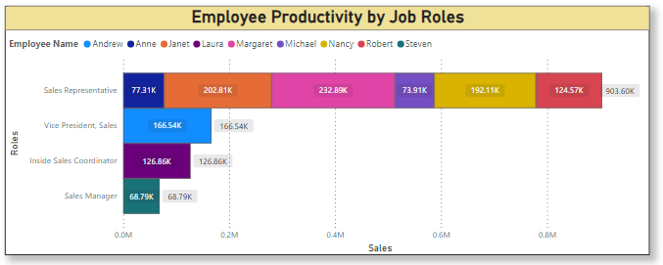
Power Bi Question
7. How does employee productivity vary across different departments or job roles? Can we create a stacked bar chart or grouped column chart to visualize it?
Answer:
Yes, we can create stacked bar chart, which shows sales representative have highest employee productivity around 903k and Employee Name Margaret have 232.89k sales.

Slide 19
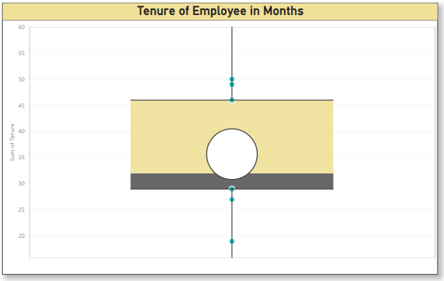
Power Bi Question
8. What is the distribution of employee tenure ? Can we create a histogram or box plot to display it ?
Answer:
Yes, we can create box plot chart, It appears to show employee tenure data from a company. The median tenure is 32 months and mean is 35.67.
The interquartile range (IQR) is around 17 months, most of employees have tenures between 29 and 46 months.

Slide 20
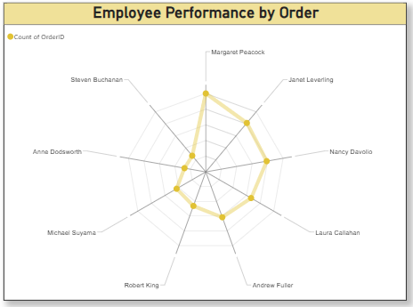
Power Bi Question
9. Can we visualize employee performance ratings or KPIs using a radar chart or bullet graph?
Answer:
Yes, we can create radar chart to check employee performance by number of orders. It shows Margaret Peacock have sold maximum 156 orders help us to identify employee performance.

Slide 21
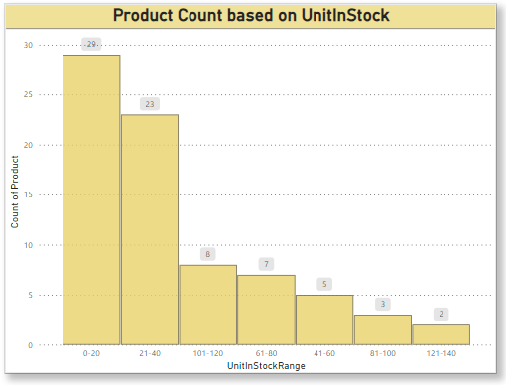
Power Bi Question
10. What is the distribution of product ratings or reviews? Can we create a histogram or stacked bar chart to visualize it?
Answer:
Yes, we can create histogram chart to find product rating based on product count. Maximum the product in stock, maximum demand of that product.
It help us to identify the best rating product.

Slide 22
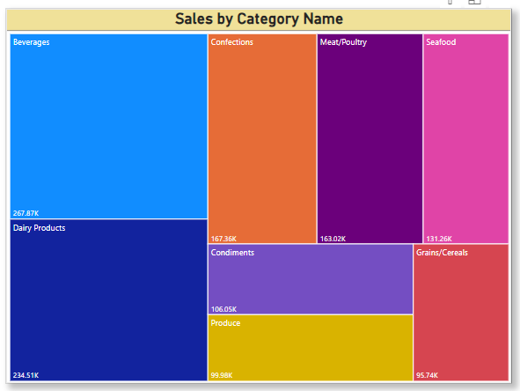
Power Bi Question
11. How does the sales volume vary across different product categories? Can we create a bar chart or treemap to display it ?
Answer:
Yes, we can create treemap to identify sales volume across different categories which help us to focus on that category to gain more profits. According to this chart, Beverages have the maximum sales volume.

Slide 23
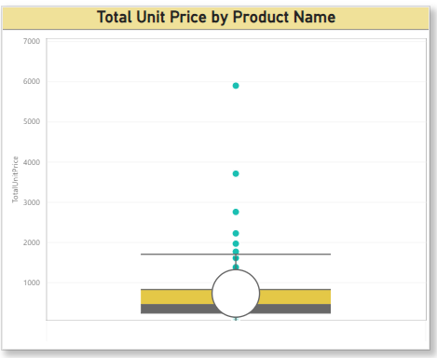
Power Bi Question
12. Can we visualize the pricing distribution of products using a box plot or violin plot ?
Answer:
Yes, we can create box plot chart to measure pricing distribution of product. It help us to identify outlier price. IQR is 584.95 and mean is 733.78.

Slide 24
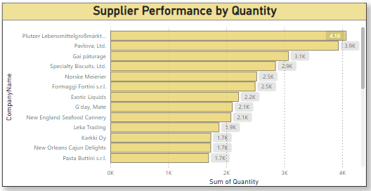
Power Bi Question
13. What is the distribution of supplier ratings or performance metrics? Can we create a bar chart or radar chart to visualize it
Answer:
Yes, we can create bar chart to identify supplier performance, it shows the total quantity shipped by each supplier company, which will help us to identify most trustworthy supplier.

Slide 25
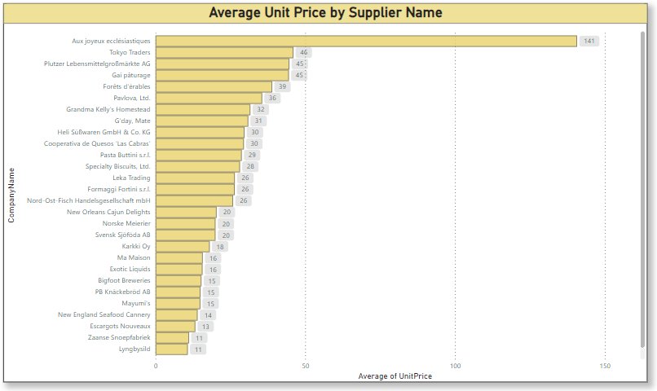
Power Bi Question
14. How does the cost or pricing structure vary across different suppliers? Can we create a box plot or stacked bar chart to display it ?
Answer:
Yes, we can create bar chart to identify average pricing structure of each supplier company.

Slide 26
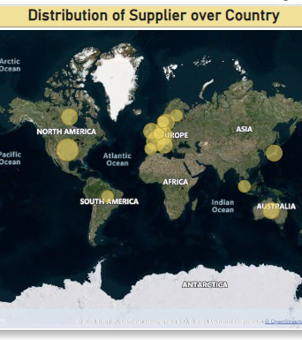
Power Bi Question
15. Can we visualize the geographical distribution of suppliers using a map or bubble chart?
Answer:
Yes, we can create map to understand suppliers’ distribution across different country.

Slide 27
Dashboard Analysis
Interactive Features: The report will feature interactive elements such as dynamic filters, slicers, and drill-down capabilities to enable users to explore the data according to their specific needs. Users can filter data by date range, product category, customer segment, or employee, allowing for deeper insights into various aspects of the company's operations.
Expected Impact: The implementation of this Power BI report is expected to revolutionize how Northwind Traders interacts with its data, providing stakeholders with actionable insights that drive business growth and competitiveness in the wholesale market landscape. By leveraging data-driven decision-making processes, the company can optimize sales strategies, improve customer satisfaction, and streamline inventory management, ultimately enhancing overall operational efficiency and profitability.

Slide 28
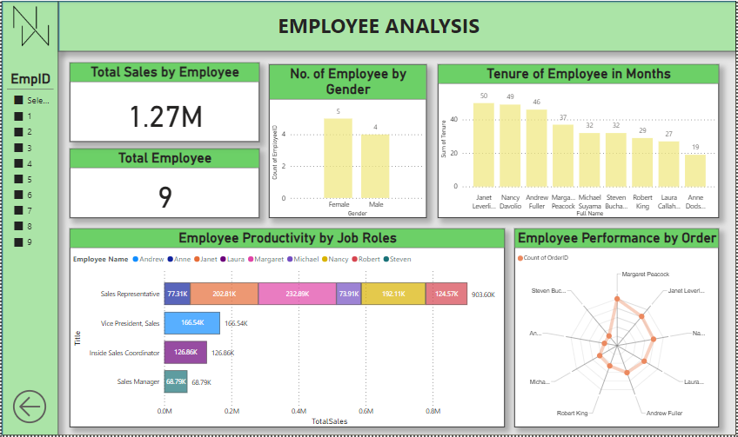
EMPLOYEE DASHBOARD

Slide 29
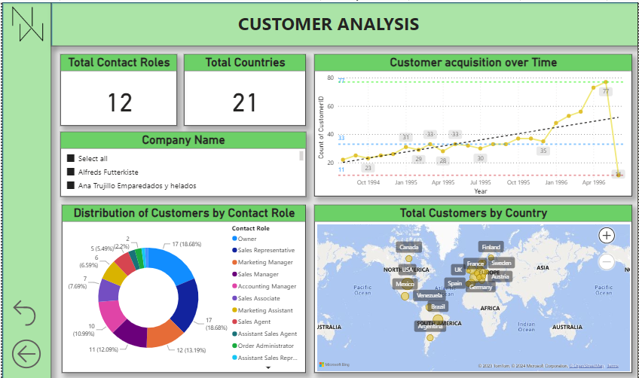
CUSTOMER DASHBOARD

Slide 30
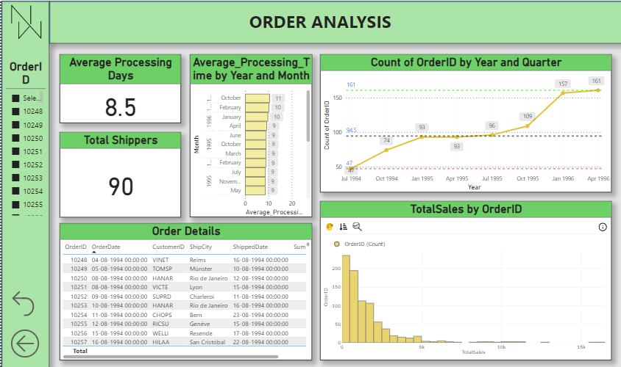
ORDER DASHBOARD

Slide 31
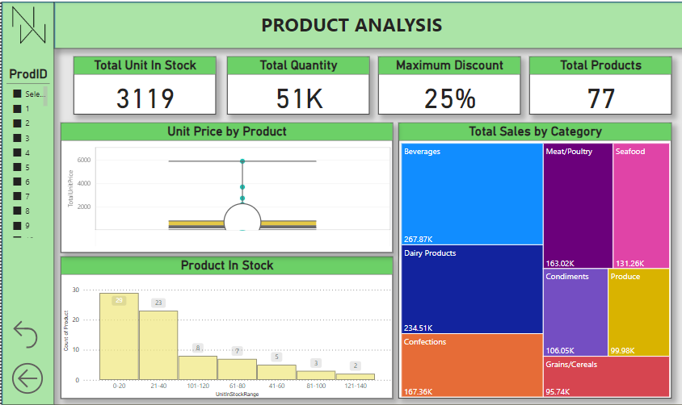
PRODUCT DASHBOARD

Slide 32
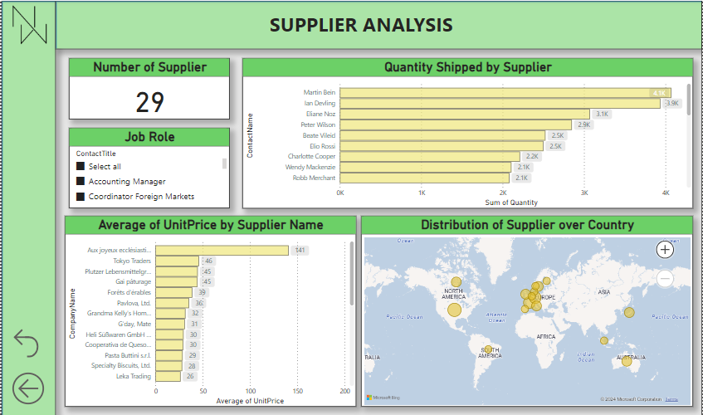
SUPPLIER DASHBOARD

Slide 33
EDA Questions

Slide 34
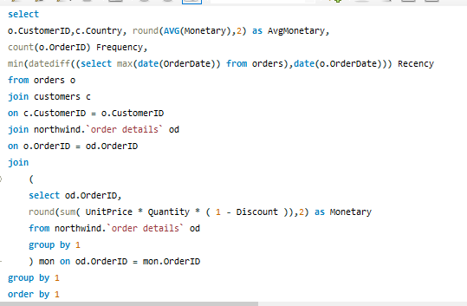
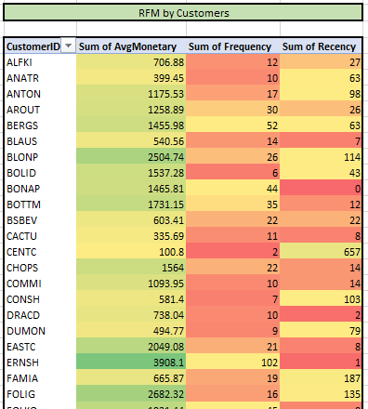
EDA Question
1. What are the key factors influencing customer retention or loyalty based on the dataset ?
Conclusion: - Key factors to check customers loyalty is based on RFM. R stands for Recency, F stands for Frequency, M stands for Monetary. It helps you to understand loyalty of customers. Higher the frequency and lower the Recency gives you the loyal customers.

Slide 35
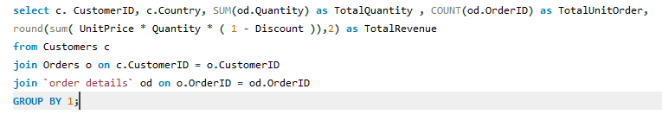
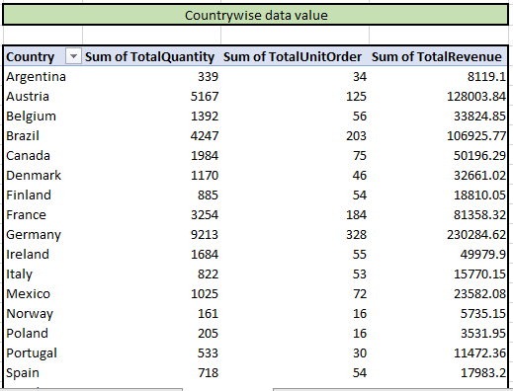
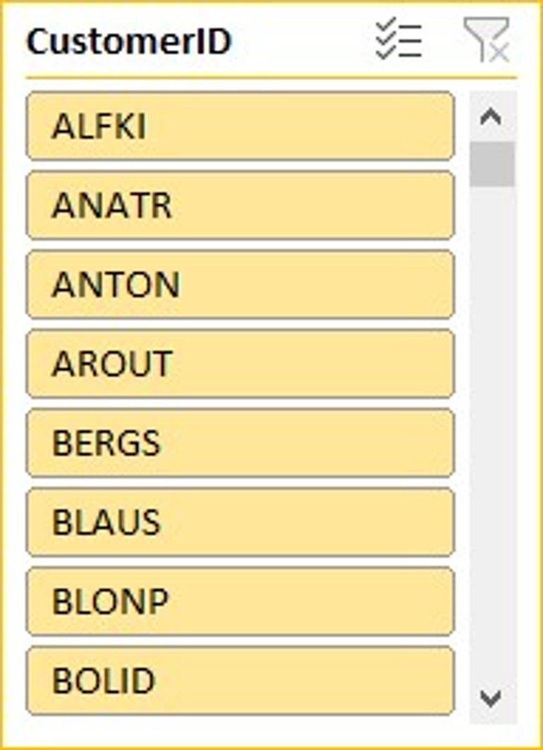
EDA Question
2. How do customer preferences vary based on their location or demographics? Can we explore this through interactive visualizations ?
Conclusion: - This query will provide us the Total Quantity, Total Unit in Order, and Total Revenue by customers in each country, which will help us to identify customers sales trend across different countries.

Slide 36
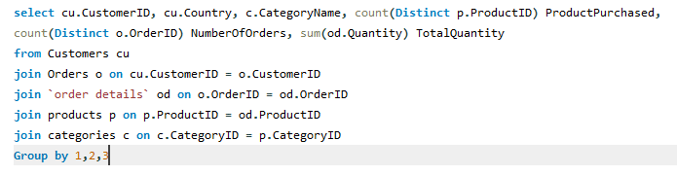
EDA Question
3. Are there any interesting patterns or clusters in customer behavior that can be visualized to identify potential market segments ?
Conclusion: - This provide us the market pattern of customer across different country and different categories, it tell us the total quantity purchased by customer in each categories which will provide us the best market segment to focus on.

Slide 37
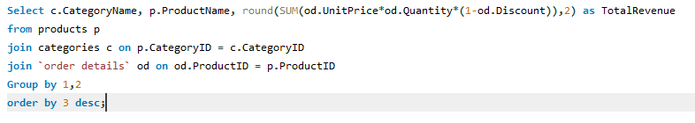
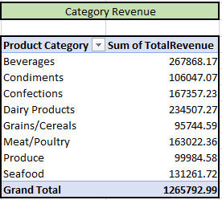
EDA Question
4. Are there any specific product categories or SKUs that contribute significantly to order revenue? Can we identify them through visualizations ?
Conclusion: - This query will give order revenue generated by each category. It help use to identify highest order revenue by categories. It show Beverages have highest revenue of $267868.

Slide 38
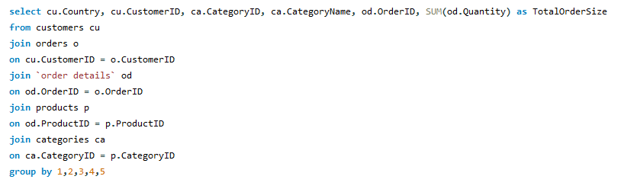
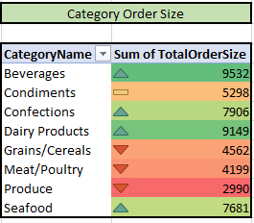
EDA Question
5. Are there any correlations between order size and customer demographics or product categories? Can we explore this visually using scatter plots or heatmaps ?
Conclusion: - This query help us to create correlation between customers and order size. It also create correlation between category and order size. Which display categoryID and amount of order done by it. And also display most ordered Category name.

Slide 39
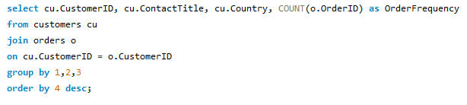
EDA Question
6. How does order frequency vary across different customer segments? Can we visualize this using bar charts or treemaps ?
Conclusion: - This sql command will provide us the order frequency across different customer segments. we have use 2 customer segments
1. Customers Country
2. Customer Contact Role
It will show us the order frequency of customers across different country and different contact roles.

Slide 40
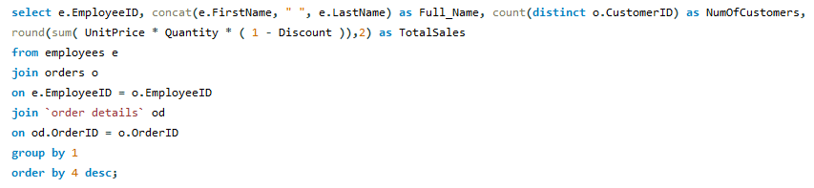
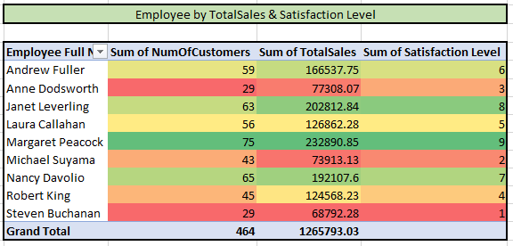
EDA Question
7. Are there any correlations between employee satisfaction levels and key performance indicators? Can we explore this visually through scatter plots or line charts ?
Conclusion: - This command will provide us the Employee full name, total customers and total sales based on total sales we have given levels to each employee higher the sales higher the level based on that we have created scatter chart to identify correlation patterns. It shows employee
Margaret Peacock have highest
Total Sales $232890 with satisfaction level 9.

Slide 41
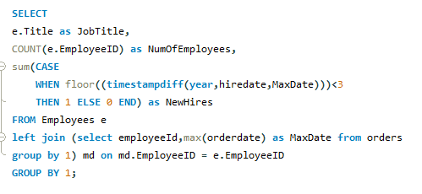
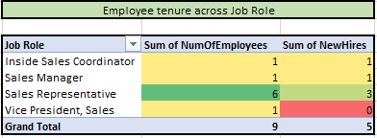
EDA Question
8. How does employee turnover vary across different departments or job roles? Can we visualize this using bar charts or heatmaps ?
Conclusion: - This sql query will provide the last 3 years employee hire date. It will help us to analyze employee turnover across different roles. It shows Sales Representative have highest employee new hires and total employee number of employees.

Slide 42
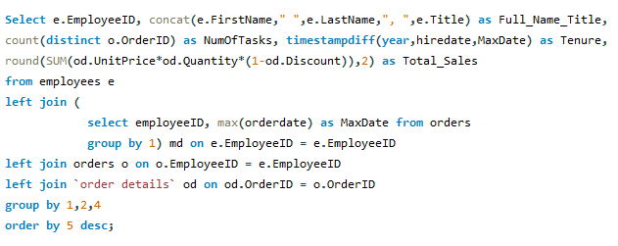
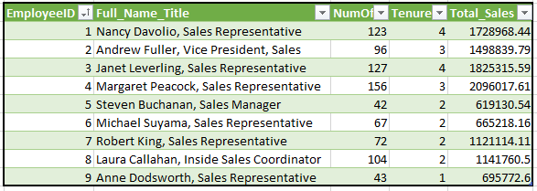
EDA Question
9. Can we identify any patterns or clusters in employee skill sets or qualifications through visualizations? How can this information be used for talent management ?
Conclusion: - This shows skill set of employees with the help of total tasks and total sales. EmployeeID 4 – Margaret Peacock, Sales Representative have the highest number of task with total sales $2096017.

Slide 43
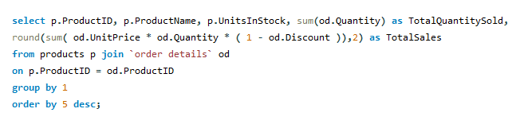
EDA Question
10. Are there any correlations between product attributes (e.g., size, color, features) and sales performance? Can we explore this visually using scatter plots or heatmaps ?
Conclusion: - In this question we have to find any correlation between products and sales performance. It shows weak relation between product unit in stock and total quantity sold this is because the less promote or product is not useful.

Slide 44
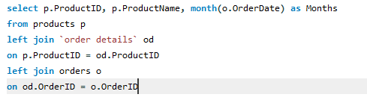
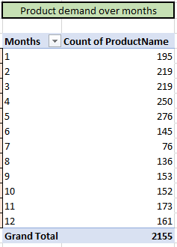
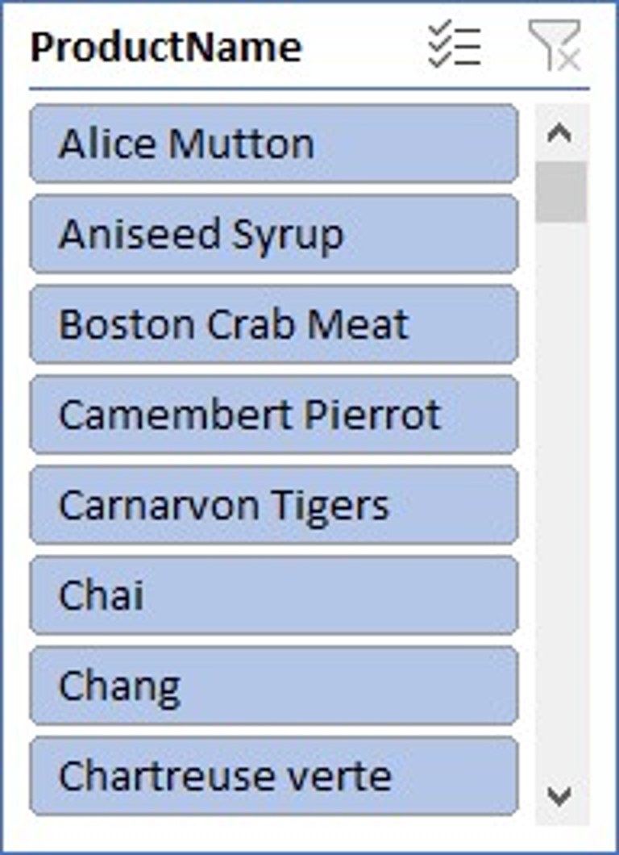
EDA Question
11. How does product demand fluctuate over different seasons or months? Can we visualize this through line charts or area charts ?
Conclusion: - This query will provide the product demands in each months. It shows 5th month is having highest product demand with 276 product count.

Slide 45
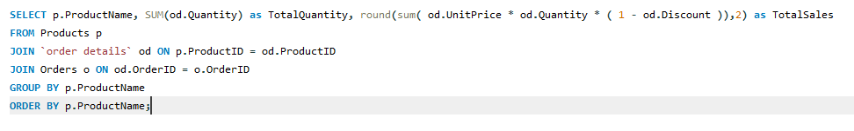
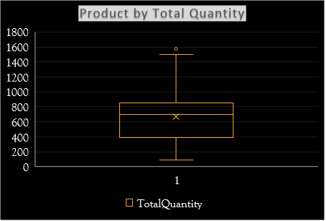
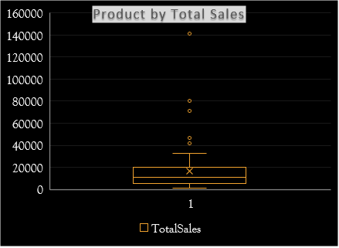
EDA Question
12. Can we identify any outliers or anomalies in product performance or sales using visualizations? How can this information be used for product optimization ?
Conclusion: - This query will provide the outliers in Total sales and Total quantity in product. Which will help us to analyze the product performance ranges based on total sales and total quantity.

Slide 46
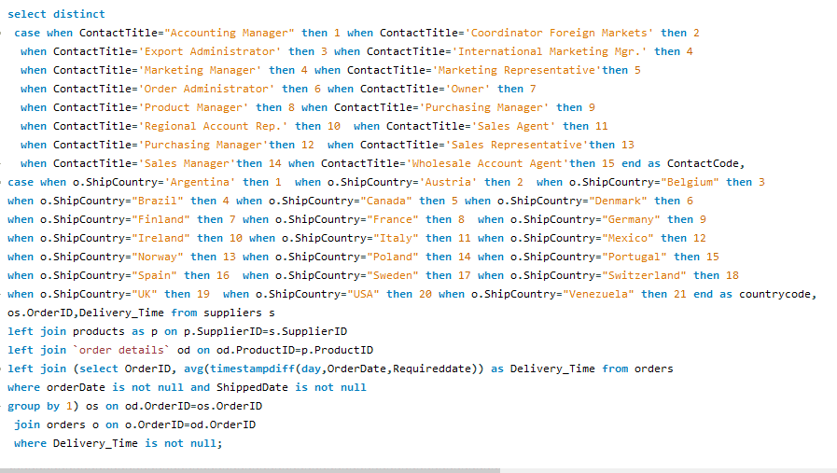
EDA Question
13. Are there any correlations between supplier attributes (e.g., location, size, industry) and performance metrics (e.g., on-time delivery, product quality) ? Can we explore this visually through scatter plots or heatmaps ?
Conclusion: - This sql command will show weak correlation between supplier attributes and its performance metrics. We have made scatter chart to identify supplier contact title and delivery time.

Slide 47
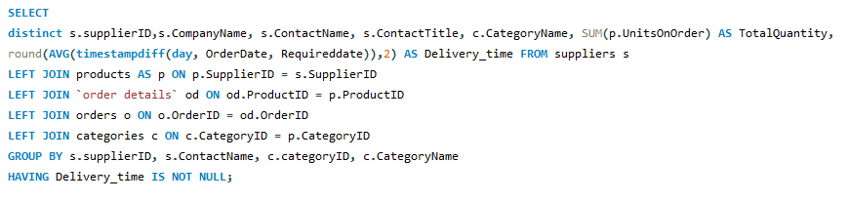
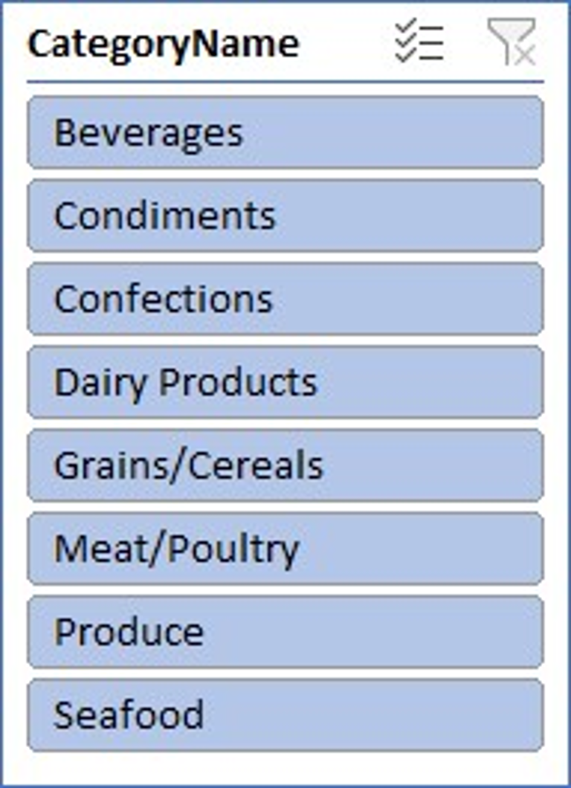
EDA Question
14. How does supplier performance vary across different product categories or departments ? Can we visualize this using stacked bar charts or grouped column charts ?
Conclusion: - This sql command will help us to identify supplier performance across different categories.
we have made combo chart to display supplier Ids and their average time and total quantity supplied by them in different product categories.

Slide 48
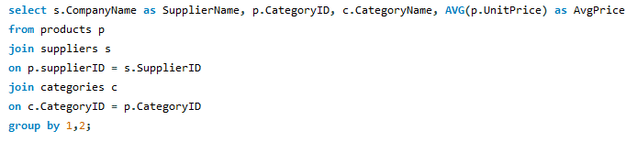
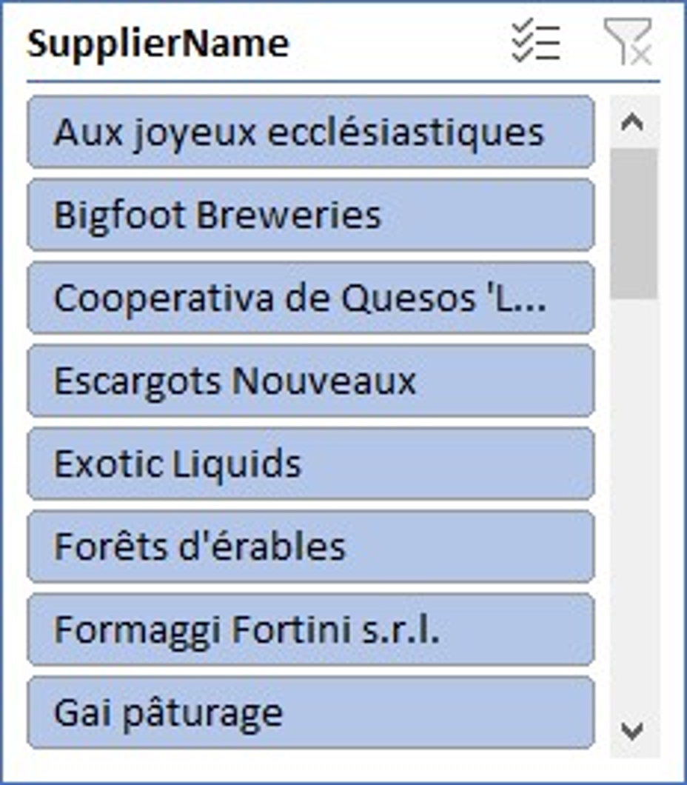

EDA Question
15. Can we identify any trends or patterns in supplier costs or pricing structures through visualizations? How can this information be used for procurement optimization ?
Conclusion: - This command will provide us the average pricing of each suppliers in different categories. Which help us to compare pricing between different suppliers in different categories.

Slide 49
Conclusion
In conclusion, leveraging the data available in the Northwind database through Power BI can provide valuable insights into customer behavior, sales patterns, employee performance, inventory management, supplier relationships, shipping efficiency, and overall business performance. These insights can empower Northwind Traders to make data-driven decisions that drive business growth and competitiveness in the wholesale market landscape.

